Slide 2
Analyzing the Firm’s Cash Flow
Cash flow (as opposed to accounting “profits”) is the primary ingredient in any financial valuation model.
From an accounting perspective, cash flow is summarized in a firm’s statement of cash flows.
From a financial perspective, firms often focus on both operating cash flow, which is used in managerial decision-making, and free cash flow, which is closely monitored by participants in the capital market.

Slide 3
Developing the Statement of Cash Flows
The statement of cash flows summarizes the firm’s cash flow over a given period of time.
Firm’s cash flows fall into three categories:
Operating flows: cash flows directly related to sale and production of the firm’s products and services.
Investment flows: cash flows associated with purchase and sale of both fixed assets and equity investments in other firms.
Financing flows: cash flows that result from debt and equity financing transactions; include incurrence and repayment of debt, cash inflow from the sale of stock, and cash outflows to repurchase stock or pay cash dividends.

Slide 4
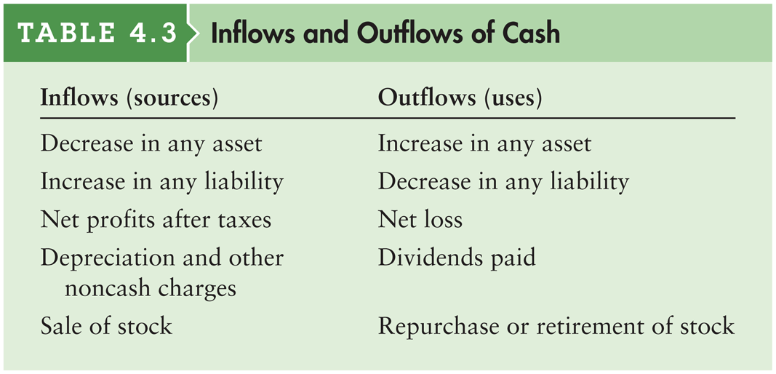
Table 4.3 Inflows and Outflows of Cash

Slide 5
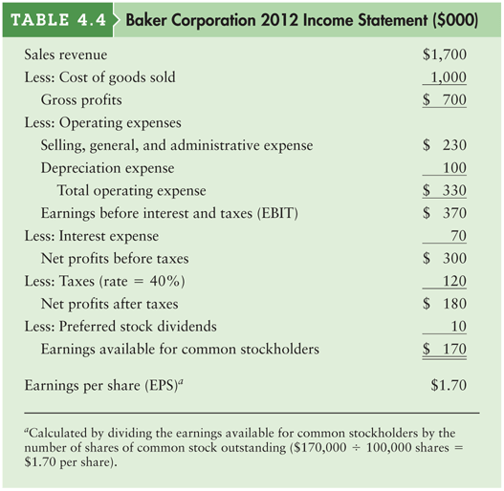
Table 4.4 Baker Corporation 2012 Income Statement ($000)

Slide 6
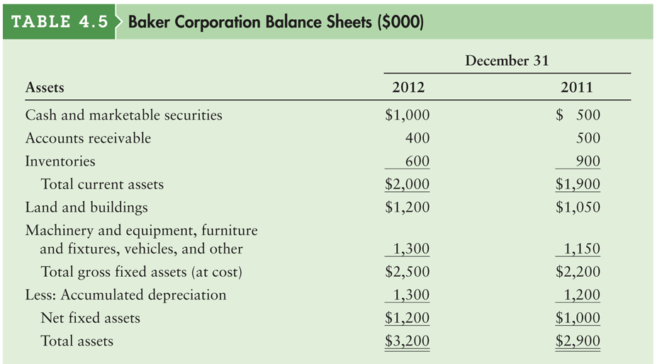
Table 4.5a Baker Corporation Balance Sheets ($000)

Slide 7
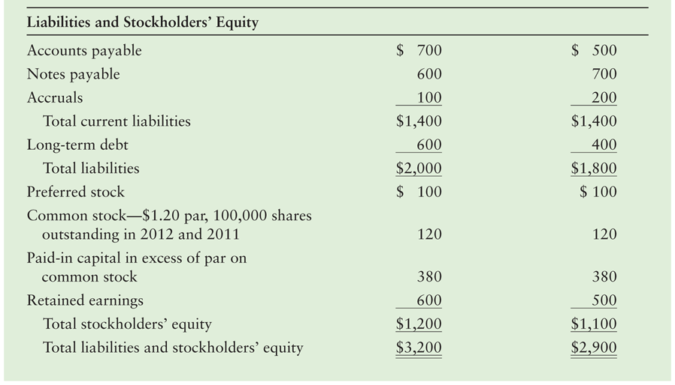
Table 4.5b Baker Corporation Balance Sheets ($000)

Slide 8
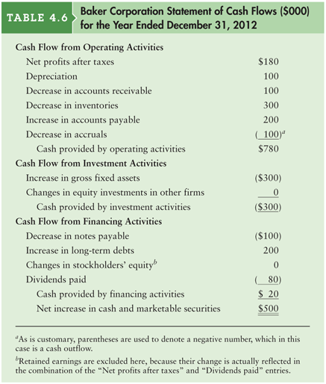
Table 4.6 Baker Corporation Statement of Cash Flows ($000) for the Year Ended December 31, 2012

Slide 9
Interpreting Statement of Cash Flows
The statement of cash flows ties the balance sheet at the beginning of the period with the balance sheet at the end of the period after considering the performance of the firm during the period through the income statement.
The net increase (or decrease) in cash and marketable securities should be equivalent to the difference between the cash and marketable securities on the balance sheet at the beginning of the year and the end of the year.

Slide 10
Operating Cash Flow
A firm’s operating Cash Flow (OCF) is the cash flow a firm generates from normal operations—from the production and sale of its goods and services.
OCF may be calculated as follows:
NOPAT = EBIT × (1 – T)
OCF = NOPAT + Depreciation
OCF = [EBIT × (1 – T)] + Depreciation

Slide 11
Operating Cash Flow (cont.)
Substituting for Baker Corporation, we get:
Thus, we can conclude that Baker’s operations are generating positive operating cash flows.
OCF = [$370 × (1 – .40)] + $100 = $322

Slide 12
Free Cash Flow
Free cash flow (FCF) is the amount of cash flow available to investors (creditors and owners) after the firm has met all operating needs and paid for investments in net fixed assets (NFAI) and net current assets (NCAI).
Where:
FCF = OCF – NFAI – NCAI
NFAI = Change in net fixed assets + Depreciation
NCAI = Change in CA – Change in (A/P + Accruals)

Slide 13
Free Cash Flow (cont.)
Using Baker Corporation we get:
Thus, the firm generated adequate cash flow to cover all of its operating costs and investments and had free cash flow available to pay investors.
NFAI = [($1,200 – $1,000) + $100] = $300
NCAI = [($2,000 – $1,900)-($800 - $700)] = $0
FCF = $322 – $300 – $0 = $22

