Slide 1
CHAPTER 4
PROBABILITY
Prem Mann, Introductory Statistics, 7/E Copyright © 2010 John Wiley & Sons. All right reserved

Slide 2
EXPERIMENT, OUTCOMES, AND SAMPLE SPACE
Definition
An experiment is a process that, when performed, results in one and only one of many observations. These observations are called that outcomes of the experiment. The collection of all outcomes for an experiment is called a sample space.
Prem Mann, Introductory Statistics, 7/E Copyright © 2010 John Wiley & Sons. All right reserved

Slide 3
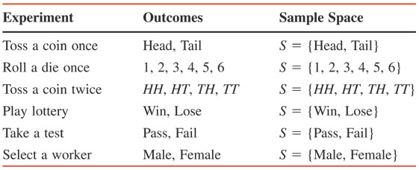
Table 4.1 Examples of Experiments, Outcomes, and Sample Spaces
Prem Mann, Introductory Statistics, 7/E Copyright © 2010 John Wiley & Sons. All right reserved

Slide 4
Example 4-1
Draw the Venn and tree diagrams for the experiment of tossing a coin once.
Prem Mann, Introductory Statistics, 7/E Copyright © 2010 John Wiley & Sons. All right reserved

Slide 5
Figure 4.1 (a) Venn Diagram and (b) tree diagram for one toss of a coin.
Prem Mann, Introductory Statistics, 7/E Copyright © 2010 John Wiley & Sons. All right reserved

Slide 6
Example 4-2
Draw the Venn and tree diagrams for the experiment of tossing a coin twice.
Prem Mann, Introductory Statistics, 7/E Copyright © 2010 John Wiley & Sons. All right reserved

Slide 7
Figure 4.2 (a) Venn diagram and (b) tree diagram for two tosses of a coin.
Prem Mann, Introductory Statistics, 7/E Copyright © 2010 John Wiley & Sons. All right reserved

Slide 8
Example 4-3
Suppose we randomly select two workers from a company and observe whether the worker selected each time is a man or a woman. Write all the outcomes for this experiment. Draw the Venn and tree diagrams for this experiment.
Prem Mann, Introductory Statistics, 7/E Copyright © 2010 John Wiley & Sons. All right reserved

Slide 9
Figure 4.3 (a) Venn diagram and (b) tree diagram for selecting two workers.
Prem Mann, Introductory Statistics, 7/E Copyright © 2010 John Wiley & Sons. All right reserved

Slide 10
Simple and Compound Events
Definition
An event is a collection of one or more of the outcomes of an experiment.
Prem Mann, Introductory Statistics, 7/E Copyright © 2010 John Wiley & Sons. All right reserved

Slide 11
Simple and Compound Events
Definition
An event that includes one and only one of the (final) outcomes for an experiment is called a simple event and is denoted by E_{i}.
Prem Mann, Introductory Statistics, 7/E Copyright © 2010 John Wiley & Sons. All right reserved

Slide 12
Example 4-4
Reconsider Example 4-3 on selecting two workers from a company and observing whether the worker selected each time is a man or a woman. Each of the final four outcomes (MM, MW, WM, and WW) for this experiment is a simple event. These four events can be denoted by E₁, E₂, E₃, and E₄, respectively. Thus,
E₁ = (MM), E₂ = (MW), E₃ = (WM), and E₄ = (WW)
Prem Mann, Introductory Statistics, 7/E Copyright © 2010 John Wiley & Sons. All right reserved

Slide 13
Simple and Compound Events
Definition
A compound event is a collection of more than one outcome for an experiment.
Prem Mann, Introductory Statistics, 7/E Copyright © 2010 John Wiley & Sons. All right reserved

Slide 14
Example 4-5
Reconsider Example 4-3 on selecting two workers from a company and observing whether the worker selected each time is a man or a woman. Let A be the event that at most one man is selected. Event A will occur if either no man or one man is selected. Hence, the event A is given by
A = {MW, WM, WW}
Because event A contains more than one outcome, it is a compound event. The Venn diagram in Figure 4.4 gives a graphic presentation of compound event A.
Prem Mann, Introductory Statistics, 7/E Copyright © 2010 John Wiley & Sons. All right reserved

Slide 15
Figure 4.4 Venn diagram for event A.
Prem Mann, Introductory Statistics, 7/E Copyright © 2010 John Wiley & Sons. All right reserved

Slide 16
Example 4-6
In a group of a people, some are in favor of genetic engineering and others are against it. Two persons are selected at random from this group and asked whether they are in favor of or against genetic engineering. How many distinct outcomes are possible? Draw a Venn diagram and a tree diagram for this experiment. List all the outcomes included in each of the following events and mention whether they are simple or compound events.
(a) Both persons are in favor of the genetic engineering.
(b) At most one person is against genetic engineering.
(c) Exactly one person is in favor of genetic engineering.
Prem Mann, Introductory Statistics, 7/E Copyright © 2010 John Wiley & Sons. All right reserved

Slide 17
Example 4-6: Solution
Let
  F = a person is in favor of genetic engineering
  A = a person is against genetic engineering
  FF = both persons are in favor of genetic engineering
  FA = the first person is in favor and the second is against
  AF = the first is against and the second is in favor
  AA = both persons are against genetic engineering
Prem Mann, Introductory Statistics, 7/E Copyright © 2010 John Wiley & Sons. All right reserved

Slide 18
Figure 4.5 Venn and tree diagrams.
Prem Mann, Introductory Statistics, 7/E Copyright © 2010 John Wiley & Sons. All right reserved

Slide 19
Example 4-6: Solution
Both persons are in favor of genetic engineering = { FF }
Because this event includes only one of the final four outcomes, it is a simple event.
At most one person is against genetic engineering = { FF, FA, AF }
Because this event includes more than one outcome, it is a compound event.
Exactly one person is in favor of genetic engineering = { FA, AF }
It is a compound event.
Prem Mann, Introductory Statistics, 7/E Copyright © 2010 John Wiley & Sons. All right reserved

Slide 20
CALCULATING PROBABLITY
Definition
Probability is a numerical measure of the likelihood that a specific event will occur.
Prem Mann, Introductory Statistics, 7/E Copyright © 2010 John Wiley & Sons. All right reserved

Slide 21

Two Properties of Probability
The probability of an event always lies in the range 0 to 1.
The sum of the probabilities of all simple events (or final outcomes) for an experiment, denoted by ΣP(E_{i}), is always 1.
Prem Mann, Introductory Statistics, 7/E Copyright © 2010 John Wiley & Sons. All right reserved

Slide 22
Three Conceptual Approaches to Probability
Classical Probability
Definition
Two or more outcomes (or events) that have the same probability of occurrence are said to be equally likely outcomes (or events).
Prem Mann, Introductory Statistics, 7/E Copyright © 2010 John Wiley & Sons. All right reserved

Slide 23
Classical Probability
Classical Probability Rule to Find Probability
Prem Mann, Introductory Statistics, 7/E Copyright © 2010 John Wiley & Sons. All right reserved

Slide 24
Example 4-7
Find the probability of obtaining a head and the probability of obtaining a tail for one toss of a coin.
Prem Mann, Introductory Statistics, 7/E Copyright © 2010 John Wiley & Sons. All right reserved

Slide 25
Example 4-7: Solution
Similarly,
Prem Mann, Introductory Statistics, 7/E Copyright © 2010 John Wiley & Sons. All right reserved

Slide 26
Example 4-8
Find the probability of obtaining an even number in one roll of a die.
Prem Mann, Introductory Statistics, 7/E Copyright © 2010 John Wiley & Sons. All right reserved

Slide 27
Example 4-8: Solution
A = {2, 4, 6}. If any one of these three numbers is obtained, event A is said to occur. Hence,
Prem Mann, Introductory Statistics, 7/E Copyright © 2010 John Wiley & Sons. All right reserved

Slide 28
Example 4-9
In a group of 500 women, 120 have played golf at least once. Suppose one of these 500 women is randomly selected. What is the probability that she has played golf at least once?
Prem Mann, Introductory Statistics, 7/E Copyright © 2010 John Wiley & Sons. All right reserved

Slide 29
Example 4-9: Solution
One hundred twenty of these 500 outcomes are included in the event that the selected woman has played golf at least once. Hence,
Prem Mann, Introductory Statistics, 7/E Copyright © 2010 John Wiley & Sons. All right reserved

Slide 30
Three Conceptual Approaches to Probability
Relative Frequency Concept of Probability
Using Relative Frequency as an Approximation of Probability
If an experiment is repeated n times and an event A is observed f times, then, according to the relative frequency concept of probability,
Prem Mann, Introductory Statistics, 7/E Copyright © 2010 John Wiley & Sons. All right reserved

Slide 31
Example 4-10
Ten of the 500 randomly selected cars manufactured at a certain auto factory are found to be lemons. Assuming that the lemons are manufactured randomly, what is the probability that the next car manufactured at this auto factory is a lemon?
Prem Mann, Introductory Statistics, 7/E Copyright © 2010 John Wiley & Sons. All right reserved

Slide 32
Example 4-10: Solution
Let n denotes the total number of cars in the sample and f the number of lemons in n. Then,
  n = 500 and f = 10
Using the relative frequency concept of probability, we obtain
Prem Mann, Introductory Statistics, 7/E Copyright © 2010 John Wiley & Sons. All right reserved

Slide 33
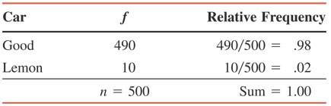
Table 4.2 Frequency and Relative Frequency Distributions for the Sample of Cars
Prem Mann, Introductory Statistics, 7/E Copyright © 2010 John Wiley & Sons. All right reserved

Slide 34
Three Conceptual Approaches to Probability
Subjective Probability
Definition
Subjective probability is the probability assigned to an event based on subjective judgment, experience, information and belief.
Prem Mann, Introductory Statistics, 7/E Copyright © 2010 John Wiley & Sons. All right reserved

Slide 35
COUNTING RULE
Counting Rule to Find Total Outcomes
If an experiment consists of three steps and if the first step can result in m outcomes, the second step in n outcomes, and the third in k outcomes, then
Total outcomes for the experiment = m · n · k
Prem Mann, Introductory Statistics, 7/E Copyright © 2010 John Wiley & Sons. All right reserved

Slide 36
Example 4-12
Suppose we toss a coin three times. This experiment has three steps: the first toss, the second toss and the third toss. Each step has two outcomes: a head and a tail. Thus,
Total outcomes for three tosses of a coin = 2 x 2 x 2 = 8
The eight outcomes for this experiment are
HHH, HHT, HTH, HTT, THH, THT, TTH, and TTT
Prem Mann, Introductory Statistics, 7/E Copyright © 2010 John Wiley & Sons. All right reserved

Slide 37
Example 4-13
A prospective car buyer can choose between a fixed and a variable interest rate and can also choose a payment period of 36 months, 48 months, or 60 months. How many total outcomes are possible?
Prem Mann, Introductory Statistics, 7/E Copyright © 2010 John Wiley & Sons. All right reserved

Slide 38
Example 4-13: Solution
There are two outcomes (a fixed or a variable interest rate) for the first step and three outcomes (a payment period of 36 months, 48 months, or 60 months) for the second step. Hence,
Total outcomes = 2 x 3 = 6
Prem Mann, Introductory Statistics, 7/E Copyright © 2010 John Wiley & Sons. All right reserved

Slide 39
Example 4-14
A National Football League team will play 16 games during a regular season. Each game can result in one of three outcomes: a win, a lose, or a tie. The total possible outcomes for 16 games are calculated as follows:
Total outcomes = 3·3·3·3·3·3·3·3·3·3·3·3·3·3·3·3
= 3¹⁶ = 43,046,721
One of the 43,046,721 possible outcomes is all 16 wins.
Prem Mann, Introductory Statistics, 7/E Copyright © 2010 John Wiley & Sons. All right reserved

Slide 40
MARGINAL AND CONDITIONAL PROBABILITIES
Suppose all 100 employees of a company were asked whether they are in favor of or against paying high salaries to CEOs of U.S. companies. Table 4.3 gives a two way classification of the responses of these 100 employees.
Prem Mann, Introductory Statistics, 7/E Copyright © 2010 John Wiley & Sons. All right reserved

Slide 41
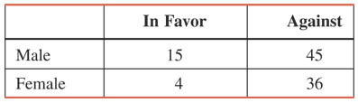
Table 4.3 Two-Way Classification of Employee Responses
Prem Mann, Introductory Statistics, 7/E Copyright © 2010 John Wiley & Sons. All right reserved

Slide 42
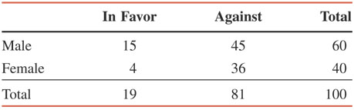
Table 4.4 Two-Way Classification of Employee Responses with Totals
Prem Mann, Introductory Statistics, 7/E Copyright © 2010 John Wiley & Sons. All right reserved

Slide 43
MARGINAL AND CONDITIONAL PROBABILITIES
Definition
Marginal probability is the probability of a single event without consideration of any other event. Marginal probability is also called simple probability.
Prem Mann, Introductory Statistics, 7/E Copyright © 2010 John Wiley & Sons. All right reserved

Slide 44
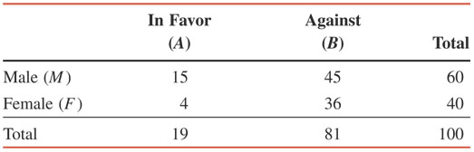
Table 4.5 Listing the Marginal Probabilities
P (M ) = 60/100 = .60
P (F ) = 40/100 = .40
P (A ) = 19/100
= .19
P (B ) = 81/100
= .81
Prem Mann, Introductory Statistics, 7/E Copyright © 2010 John Wiley & Sons. All right reserved

Slide 45
MARGINAL AND CONDITIONAL PROBABILITIES
Definition
Conditional probability is the probability that an event will occur given that another has already occurred. If A and B are two events, then the conditional probability A given B is written as
P ( A | B )
and read as “the probability of A given that B has already occurred.”
Prem Mann, Introductory Statistics, 7/E Copyright © 2010 John Wiley & Sons. All right reserved

Slide 46
Example 4-15
Compute the conditional probability P ( in favor | male) for the data on 100 employees given in Table 4.4.
Prem Mann, Introductory Statistics, 7/E Copyright © 2010 John Wiley & Sons. All right reserved

Slide 47
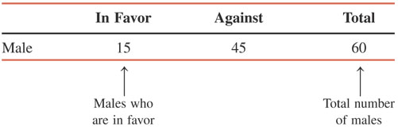
Example 4-15: Solution
Prem Mann, Introductory Statistics, 7/E Copyright © 2010 John Wiley & Sons. All right reserved

Slide 48
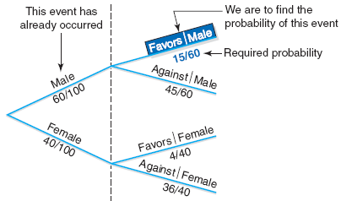
Figure 4.6 Tree Diagram.
Prem Mann, Introductory Statistics, 7/E Copyright © 2010 John Wiley & Sons. All right reserved

Slide 49
Example 4-16
For the data of Table 4.4, calculate the conditional probability that a randomly selected employee is a female given that this employee is in favor of paying high salaries to CEOs.
Prem Mann, Introductory Statistics, 7/E Copyright © 2010 John Wiley & Sons. All right reserved

Slide 50
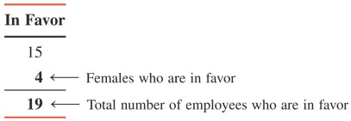
Example 4-16: Solution
Prem Mann, Introductory Statistics, 7/E Copyright © 2010 John Wiley & Sons. All right reserved

Slide 51
Figure 4.7 Tree diagram.
Prem Mann, Introductory Statistics, 7/E Copyright © 2010 John Wiley & Sons. All right reserved

Slide 52
MUTUALLY EXCLUSIVE EVENTS
Definition
Events that cannot occur together are said to be mutually exclusive events.
Prem Mann, Introductory Statistics, 7/E Copyright © 2010 John Wiley & Sons. All right reserved

Slide 53
Example 4-17
Consider the following events for one roll of a die:
  A= an even number is observed= {2, 4, 6}
  B= an odd number is observed= {1, 3, 5}
  C= a number less than 5 is observed= {1, 2, 3, 4}
Are events A and B mutually exclusive? Are events A and C mutually exclusive?
Prem Mann, Introductory Statistics, 7/E Copyright © 2010 John Wiley & Sons. All right reserved

Slide 54
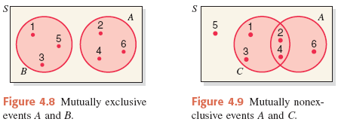
Example 4-17: Solution
Prem Mann, Introductory Statistics, 7/E Copyright © 2010 John Wiley & Sons. All right reserved

Slide 55
Example 4-18
Consider the following two events for a randomly selected adult:
  Y = this adult has shopped on the Internet at least once
  N = this adult has never shopped on the Internet
Are events Y and N mutually exclusive?
Prem Mann, Introductory Statistics, 7/E Copyright © 2010 John Wiley & Sons. All right reserved

Slide 56
Example 4-18: Solution
As we can observe from the definitions of events Y and N and from Figure 4.10, events Y and N have no common outcome. Hence, these two events are mutually exclusive.
Prem Mann, Introductory Statistics, 7/E Copyright © 2010 John Wiley & Sons. All right reserved

Slide 57
INDEPENDENT VERSUS DEPENDENT EVENTS
Definition
Two events are said to be independent if the occurrence of one does not affect the probability of the occurrence of the other. In other words, A and B are independent events if
either P(A | B) = P(A) or P(B | A) = P(B)
Prem Mann, Introductory Statistics, 7/E Copyright © 2010 John Wiley & Sons. All right reserved

Slide 58
Example 4-19
Refer to the information on 100 employees given in Table 4.4 in Section 4.4. Are events “female (F)” and “in favor (A)” independent?
Prem Mann, Introductory Statistics, 7/E Copyright © 2010 John Wiley & Sons. All right reserved

Slide 59
Example 4-19: Solution
Events F and A will be independent if
P (F) = P (F | A)
Otherwise they will be dependent.
Using the information given in Table 4.4, compute
P (F) = 40/100 = .40 and
P (F | A) = 4/19 = .2105
Because these two probabilities are not equal, the two events are dependent.
Prem Mann, Introductory Statistics, 7/E Copyright © 2010 John Wiley & Sons. All right reserved

Slide 60
Example 4-20
A box contains a total of 100 CDs that were manufactured on two machines. Of them, 60 were manufactured on Machine I. Of the total CDs, 15 are defective. Of the 60 CDs that were manufactured on Machine I, 9 are defective.
Let D be the event that a randomly selected CD is defective, and let A be the event that a randomly selected CD was manufactured on Machine I. Are events D and A independent?
Prem Mann, Introductory Statistics, 7/E Copyright © 2010 John Wiley & Sons. All right reserved

Slide 61
Example 4-20: Solution
From the given information,
P (D) = 15/100 = .15 and
P (D | A) = 9/60 = .15
Hence,
P (D) = P (D | A)
Consequently, the two events, D and A, are independent.
Prem Mann, Introductory Statistics, 7/E Copyright © 2010 John Wiley & Sons. All right reserved

Slide 62
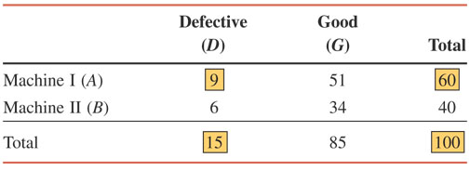
Table 4.6 Two-Way Classification Table
Prem Mann, Introductory Statistics, 7/E Copyright © 2010 John Wiley & Sons. All right reserved

Slide 63
COMPLEMENTARY EVENTS
Definition
The complement of event A, denoted by Ā and is read as “A bar” or “A complement,” is the event that includes all the outcomes for an experiment that are not in A.
Prem Mann, Introductory Statistics, 7/E Copyright © 2010 John Wiley & Sons. All right reserved

Slide 64
Figure 4.11 Venn diagram of two complementary events.
Prem Mann, Introductory Statistics, 7/E Copyright © 2010 John Wiley & Sons. All right reserved

Slide 65
Example 4-21
In a group of 2000 taxpayers, 400 have been audited by the IRS at least once. If one taxpayer is randomly selected from this group, what are the two complementary events for this experiment, and what are their probabilities?
Prem Mann, Introductory Statistics, 7/E Copyright © 2010 John Wiley & Sons. All right reserved

Slide 66
Example 4-21: Solution
The two complementary events for this experiment are
  A = the selected taxpayer has been audited by the IRS at least once
  Ā = the selected taxpayer has never been audited by the IRS
The probabilities of the complementary events are
P (A) = 400/2000 = .20 and
P (Ā) = 1600/2000 = .80
Prem Mann, Introductory Statistics, 7/E Copyright © 2010 John Wiley & Sons. All right reserved

Slide 67
Example 4-22
In a group of 5000 adults, 3500 are in favor of stricter gun control laws, 1200 are against such laws, and 300 have no opinion. One adult is randomly selected from this group. Let A be the event that this adult is in favor of stricter gun control laws. What is the complementary event of A? What are the probabilities of the two events?
Prem Mann, Introductory Statistics, 7/E Copyright © 2010 John Wiley & Sons. All right reserved

Slide 68
Example 4-22: Solution
The two complementary events for this experiment are
  A = the selected adult is in favor of stricter gun control laws
  Ā = the selected adult either is against such laws or has no opinion
The probabilities of the complementary events are
P (A) = 3500/5000 = .70 and
P (Ā) = 1500/5000 = .30
Prem Mann, Introductory Statistics, 7/E Copyright © 2010 John Wiley & Sons. All right reserved

Slide 69
INTERSECTION OF EVENTS AND THE MULTIPLICATION RULE
Intersection of Events
Definition
Let A and B be two events defined in a sample space. The intersection of A and B represents the collection of all outcomes that are common to both A and B and is denoted by
A and B
Prem Mann, Introductory Statistics, 7/E Copyright © 2010 John Wiley & Sons. All right reserved

Slide 70
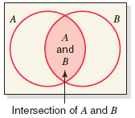
Figure 4.14 Intersection of events A and B.
Prem Mann, Introductory Statistics, 7/E Copyright © 2010 John Wiley & Sons. All right reserved

Slide 71
INTERSECTION OF EVENTS AND THE MULTIPLICATION RULE
Multiplication Rule
Definition
The probability of the intersection of two events is called their joint probability. It is written as
P(A and B)
Prem Mann, Introductory Statistics, 7/E Copyright © 2010 John Wiley & Sons. All right reserved

Slide 72
INTERSECTION OF EVENTS AND THE MULTIPLICATION RULE
Multiplication Rule to Find Joint Probability
The probability of the intersection of two events A and B is
P(A and B) = P(A) P(B |A)
Prem Mann, Introductory Statistics, 7/E Copyright © 2010 John Wiley & Sons. All right reserved

Slide 73
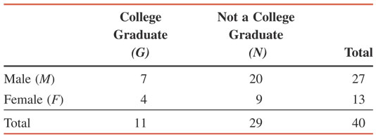
Example 4-23
Table 4.7 gives the classification of all employees of a company given by gender and college degree.
Prem Mann, Introductory Statistics, 7/E Copyright © 2010 John Wiley & Sons. All right reserved

Slide 74
Example 4-23
If one of these employees is selected at random for membership on the employee-management committee, what is the probability that this employee is a female and a college graduate?
Prem Mann, Introductory Statistics, 7/E Copyright © 2010 John Wiley & Sons. All right reserved

Slide 75
Example 4-23: Solution
We are to calculate the probability of the intersection of the events F and G.
P(F and G) = P(F) P(G |F)
P(F) = 13/40
P(G |F) = 4/13
P(F and G) = P(F) P(G |F)
= (13/40)(4/13) = .100
Prem Mann, Introductory Statistics, 7/E Copyright © 2010 John Wiley & Sons. All right reserved

Slide 76
Figure 4.15 Intersection of events F and G.
Prem Mann, Introductory Statistics, 7/E Copyright © 2010 John Wiley & Sons. All right reserved

Slide 77
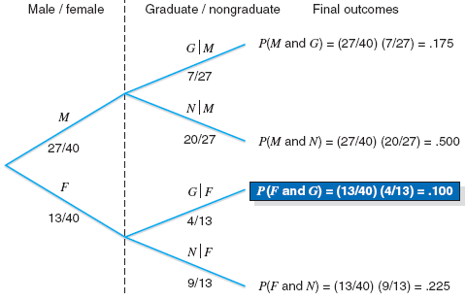
Figure 4.16 Tree diagram for joint probabilities.
Prem Mann, Introductory Statistics, 7/E Copyright © 2010 John Wiley & Sons. All right reserved

Slide 78
Example 4-24
A box contains 20 DVDs, 4 of which are defective. If two DVDs are selected at random (without replacement) from this box, what is the probability that both are defective?
Prem Mann, Introductory Statistics, 7/E Copyright © 2010 John Wiley & Sons. All right reserved

Slide 79
Example 4-24: Solution
Let us define the following events for this experiment:
G₁ = event that the first DVD selected is good
D₁ = event that the first DVD selected is defective
G₂ = event that the second DVD selected is good
D₂ = event that the second DVD selected is defective
We are to calculate the joint probability of D₁ and D₂,
P(D₁ and D₂) = P(D₁) P(D₂ |D₁)
P(D₁) = 4/20
P(D₂ |D₁) = 3/19
P(D₁ and D₂) = (4/20)(3/19) = .0316
Prem Mann, Introductory Statistics, 7/E Copyright © 2010 John Wiley & Sons. All right reserved

Slide 80
Figure 4.17 Selecting two DVDs.
Prem Mann, Introductory Statistics, 7/E Copyright © 2010 John Wiley & Sons. All right reserved

Slide 81
INTERSECTION OF EVENTS AND THE MULTIPLICATION RULE
Calculating Conditional Probability
If A and B are two events, then,
given that P (A ) ≠ 0 and P (B ) ≠ 0.
Prem Mann, Introductory Statistics, 7/E Copyright © 2010 John Wiley & Sons. All right reserved

Slide 82
Example 4-25
The probability that a randomly selected student from a college is a senior is .20, and the joint probability that the student is a computer science major and a senior is .03. Find the conditional probability that a student selected at random is a computer science major given that the student is a senior.
Prem Mann, Introductory Statistics, 7/E Copyright © 2010 John Wiley & Sons. All right reserved

Slide 83
Example 4-25: Solution
Let us define the following two events:
  A = the student selected is a senior
  B = the student selected is a computer science major
From the given information,
P(A) = .20 and P(A and B) = .03
Hence,
P (B | A) = P(A and B)/P(A) = .03/.20 = .15
Prem Mann, Introductory Statistics, 7/E Copyright © 2010 John Wiley & Sons. All right reserved

Slide 84
Multiplication Rule for Independent Events
Multiplication Rule to Calculate the Probability of Independent Events
The probability of the intersection of two independent events A and B is
P(A and B) = P(A) P(B)
Prem Mann, Introductory Statistics, 7/E Copyright © 2010 John Wiley & Sons. All right reserved

Slide 85
Example 4-26
An office building has two fire detectors. The probability is .02 that any fire detector of this type will fail to go off during a fire. Find the probability that both of these fire detectors will fail to go off in case of a fire.
Prem Mann, Introductory Statistics, 7/E Copyright © 2010 John Wiley & Sons. All right reserved

Slide 86
Example 4-26: Solution
We define the following two events:
  A = the first fire detector fails to go off during a fire
  B = the second fire detector fails to go off during a fire
Then, the joint probability of A and B is
P(A and B) = P(A) P(B) = (.02)(.02) = .0004
Prem Mann, Introductory Statistics, 7/E Copyright © 2010 John Wiley & Sons. All right reserved

Slide 87
Example 4-27
The probability that a patient is allergic to penicillin is .20. Suppose this drug is administered to three patients.
  Find the probability that all three of them are allergic to it.
  Find the probability that at least one of the them is not allergic to it.
Prem Mann, Introductory Statistics, 7/E Copyright © 2010 John Wiley & Sons. All right reserved

Slide 88
Example 4-27: Solution
Let A, B, and C denote the events the first, second and third patients, respectively, are allergic to penicillin. Hence,
P (A and B and C) = P(A) P(B) P(C) = (.20) (.20) (.20) = .008
Prem Mann, Introductory Statistics, 7/E Copyright © 2010 John Wiley & Sons. All right reserved

Slide 89
Example 4-27: Solution
Let us define the following events:
  G = all three patients are allergic
  H = at least one patient is not allergic
P(G) = P(A and B and C) = .008
Therefore, using the complementary event rule, we obtain
P(H) = 1 – P(G) = 1 - .008 = .992
Prem Mann, Introductory Statistics, 7/E Copyright © 2010 John Wiley & Sons. All right reserved

Slide 90
Figure 4.18 Tree diagram for joint probabilities.
Prem Mann, Introductory Statistics, 7/E Copyright © 2010 John Wiley & Sons. All right reserved

Slide 91
Multiplication Rule for Independent Events
Joint Probability of Mutually Exclusive Events
The joint probability of two mutually exclusive events is always zero. If A and B are two mutually exclusive events, then
P(A and B) = 0
Prem Mann, Introductory Statistics, 7/E Copyright © 2010 John Wiley & Sons. All right reserved

Slide 92
Example 4-28
Consider the following two events for an application filed by a person to obtain a car loan:
  A = event that the loan application is approved
  R = event that the loan application is rejected
What is the joint probability of A and R?
Prem Mann, Introductory Statistics, 7/E Copyright © 2010 John Wiley & Sons. All right reserved

Slide 93
Example 4-28: Solution
The two events A and R are mutually exclusive. Either the loan application will be approved or it will be rejected. Hence,
P(A and R) = 0
Prem Mann, Introductory Statistics, 7/E Copyright © 2010 John Wiley & Sons. All right reserved

Slide 94
UNION OF EVENTS AND THE ADDITION RULE
Definition
Let A and B be two events defined in a sample space. The union of events A and B is the collection of all outcomes that belong to either A or B or to both A and B and is denoted by
A or B
Prem Mann, Introductory Statistics, 7/E Copyright © 2010 John Wiley & Sons. All right reserved

Slide 95
Example 4-29
A senior citizen center has 300 members. Of them, 140 are male, 210 take at least one medicine on a permanent basis, and 95 are male and take at least one medicine on a permanent basis. Describe the union of the events “male” and “take at least one medicine on a permanent basis.”
Prem Mann, Introductory Statistics, 7/E Copyright © 2010 John Wiley & Sons. All right reserved

Slide 96
Example 4-29: Solution
Let us define the following events:
  M = a senior citizen is a male
  F = a senior citizen is a female
  A = a senior citizen takes at least one medicine
  B = a senior citizen does not take any medicine
The union of the events “male” and “take at least one medicine” includes those senior citizens who are either male or take at least one medicine or both. The number of such senior citizen is
140 + 210 – 95 = 255
Prem Mann, Introductory Statistics, 7/E Copyright © 2010 John Wiley & Sons. All right reserved

Slide 97
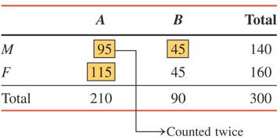
Table 4.8
Prem Mann, Introductory Statistics, 7/E Copyright © 2010 John Wiley & Sons. All right reserved

Slide 98
Figure 4.19 Union of events M and A.
Prem Mann, Introductory Statistics, 7/E Copyright © 2010 John Wiley & Sons. All right reserved

Slide 99
UNION OF EVENTS AND THE ADDITION RULE
Addition Rule
Addition Rule to Find the Probability of Union of Events
The portability of the union of two events A and B is
P(A or B) = P(A) + P(B) – P(A and B)
Prem Mann, Introductory Statistics, 7/E Copyright © 2010 John Wiley & Sons. All right reserved

Slide 100
Example 4-30
A university president has proposed that all students must take a course in ethics as a requirement for graduation. Three hundred faculty members and students from this university were asked about their opinion on this issue. Table 4.9 gives a two-way classification of the responses of these faculty members and students.
Find the probability that one person selected at random from these 300 persons is a faculty member or is in favor of this proposal.
Prem Mann, Introductory Statistics, 7/E Copyright © 2010 John Wiley & Sons. All right reserved

Slide 101
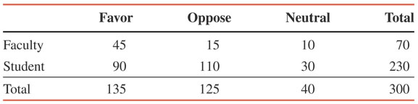
Table 4.9 Two-Way Classification of Responses
Prem Mann, Introductory Statistics, 7/E Copyright © 2010 John Wiley & Sons. All right reserved

Slide 102
Example 4-30: Solution
Let us define the following events:
  A = the person selected is a faculty member
  B = the person selected is in favor of the proposal
From the information in the Table 4.9,
  P(A) = 70/300 = .2333
  P(B) = 135/300 = .4500
  P(A and B) = P(A) P(B | A) = (70/300)(45/70) = .1500
Using the addition rule, we obtain
  P(A or B) = P(A) + P(B) – P(A and B)
  = .2333 + .4500 – .1500 = .5333
Prem Mann, Introductory Statistics, 7/E Copyright © 2010 John Wiley & Sons. All right reserved

Slide 103
Example 4-31
In a group of 2500 persons, 1400 are female, 600 are vegetarian, and 400 are female and vegetarian. What is the probability that a randomly selected person from this group is a male or vegetarian?
Prem Mann, Introductory Statistics, 7/E Copyright © 2010 John Wiley & Sons. All right reserved

Slide 104
Example 4-31: Solution
Let us define the following events:
  F = the randomly selected person is a female
  M = the randomly selected person is a male
  V = the randomly selected person is a vegetarian
  N = the randomly selected person is a non-vegetarian.
Prem Mann, Introductory Statistics, 7/E Copyright © 2010 John Wiley & Sons. All right reserved

Slide 105
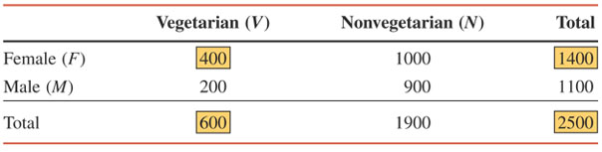
Table 4.10 Two-Way Classification Table
Prem Mann, Introductory Statistics, 7/E Copyright © 2010 John Wiley & Sons. All right reserved

Slide 106
Addition Rule for Mutually Exclusive Events
Addition Rule to Find the Probability of the Union of Mutually Exclusive Events
The probability of the union of two mutually exclusive events A and B is
P(A or B) = P(A) + P(B)
Prem Mann, Introductory Statistics, 7/E Copyright © 2010 John Wiley & Sons. All right reserved

Slide 107
Example 4-32
A university president has proposed that all students must take a course in ethics as a requirement for graduation. Three hundred faculty members and students from this university were asked about their opinion on this issue. The following table, reproduced from Table 4.9 in Example 4-30, gives a two-way classification of the responses of these faculty members and students.
What is the probability that a randomly selected person from these 300 faculty members and students is in favor of the proposal or is neutral?
Prem Mann, Introductory Statistics, 7/E Copyright © 2010 John Wiley & Sons. All right reserved

Slide 108
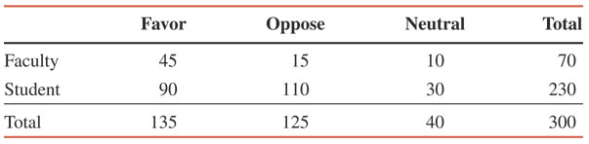
Example 4-32: Solution
Prem Mann, Introductory Statistics, 7/E Copyright © 2010 John Wiley & Sons. All right reserved

Slide 109
Example 4-32: Solution
Let us define the following events:
  F = the person selected is in favor of the proposal
  N = the person selected is neutral
From the given information,
  P(F) = 135/300 = .4500
  P(N) = 40/300 = .1333
Hence,
  P(F or N) = P(F) + P(N) = .4500 + .1333 = .5833
Prem Mann, Introductory Statistics, 7/E Copyright © 2010 John Wiley & Sons. All right reserved

