Slide 1

6
Inventories
Learning Objectives
After studying this chapter, you should be able to:
[1] Determine how to classify inventory and inventory quantities.
[2] Explain the accounting for inventories and apply the inventory cost flow methods.
[3] Explain the financial effects of the inventory cost flow assumptions.
[4] Explain the lower-of-cost-or-market basis of accounting for inventories.
[5] Indicate the effects of inventory errors on the financial statements.
[6] Compute and interpret the inventory turnover.

Slide 2
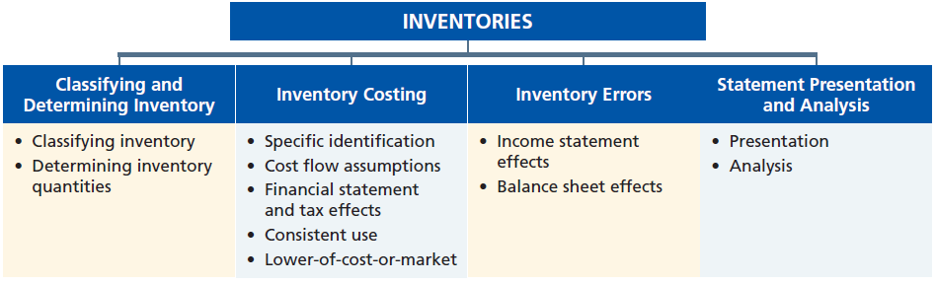
Preview of Chapter 6

Slide 3
Determining Inventory Quantities
Physical Inventory taken for two reasons:
Perpetual System
  Check accuracy of inventory records.
  Determine amount of inventory lost due to wasted raw materials, shoplifting, or employee theft.
Periodic System
  Determine the inventory on hand.
  Determine the cost of goods sold for the period.
LO 1 Determine how to classify inventory and inventory quantities.

Slide 4
Determining Inventory Quantities
Taking a Physical Inventory
Involves counting, weighing, or measuring each kind of inventory on hand.
Taken,
  when the business is closed or business is slow.
  at the end of the accounting period.
LO 1 Determine how to classify inventory and inventory quantities.

Slide 5
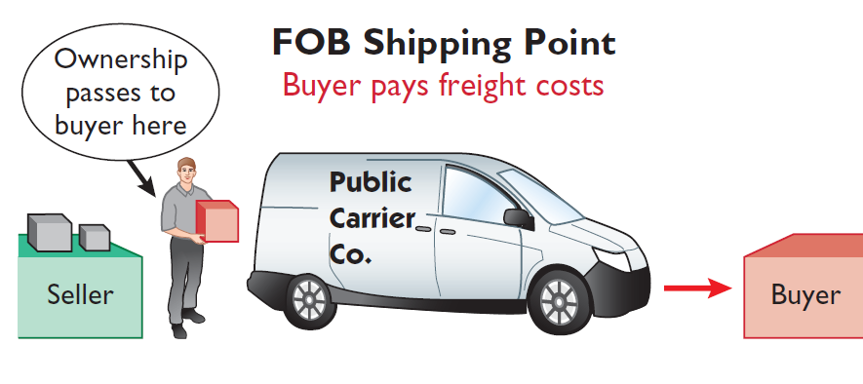
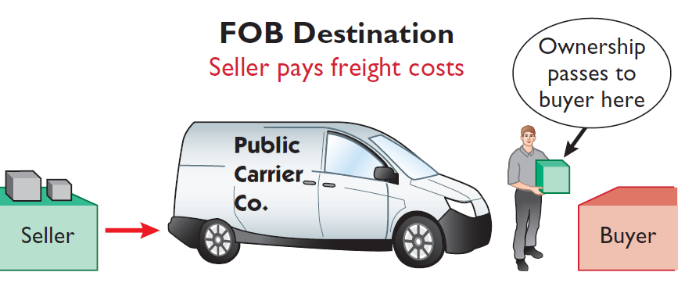
Determining Inventory Quantities
Goods in Transit
Illustration 6-2 Terms of sale
Ownership of the goods passes to the buyer when the public carrier accepts the goods from the seller.
Ownership of the goods remains with the seller until the goods reach the buyer.
LO 1 Determine how to classify inventory and inventory quantities.

Slide 6
Inventory Costing
Inventory is accounted for at cost.
  Cost includes all expenditures necessary to acquire goods and place them in a condition ready for sale.
  Unit costs are applied to quantities to determine the total cost of the inventory and the cost of goods sold using the following costing methods:
    Specific identification
    First-in, first-out (FIFO)
    Last-in, first-out (LIFO)
    Average-cost
Cost Flow Assumptions
LO 2 Explain the accounting for inventories and apply the inventory cost flow methods.

Slide 7
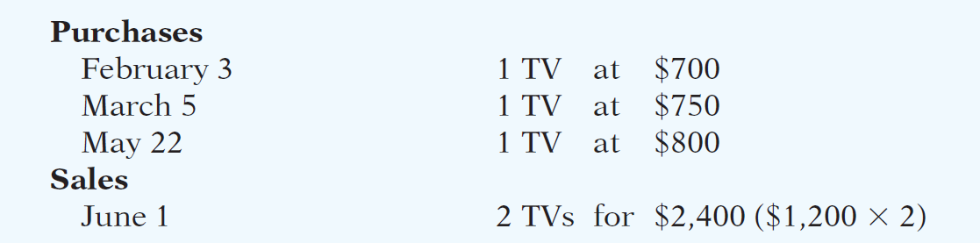
Inventory Costing
Illustration: Crivitz TV Company purchases three identical 50-inch TVs on different dates at costs of $700, $750, and $800. During the year Crivitz sold two sets at $1,200 each. These facts are summarized below.
Illustration 6-3
LO 2 Explain the accounting for inventories and apply the inventory cost flow methods.

Slide 8
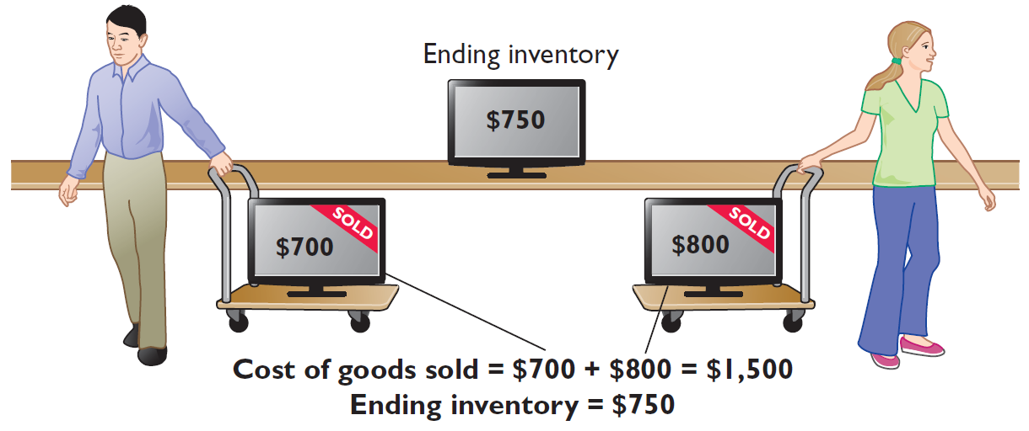
Inventory Costing
Specific Identification
If Crivitz sold the TVs it purchased on February 3 and May 22, then its cost of goods sold is $1,500 ($700 + $800), and its ending inventory is $750.
Illustration 6-4
LO 2 Explain the accounting for inventories and apply the inventory cost flow methods.

Slide 9
Inventory Costing
Specific Identification
Actual physical flow costing method in which items still in inventory are specifically costed to arrive at the total cost of the ending inventory.
  Practice is relatively rare.
  Most companies make assumptions (cost flow assumptions) about which units were sold.
LO 2 Explain the accounting for inventories and apply the inventory cost flow methods.

Slide 10
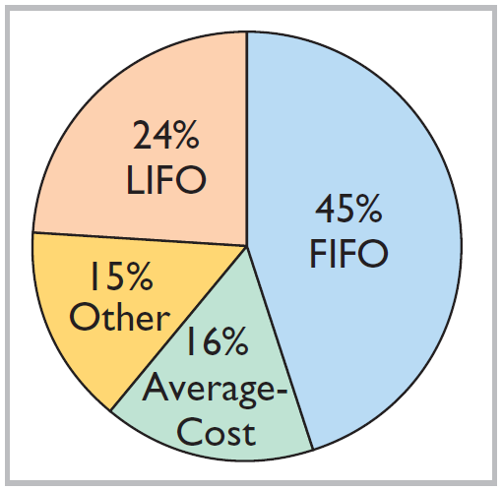
Inventory Costing
Cost Flow Assumption
does not need to be consistent with the physical movement of goods
Illustration 6-12
Use of cost flow methods in major U.S. companies
LO 2 Explain the accounting for inventories and apply the inventory cost flow methods.

Slide 11
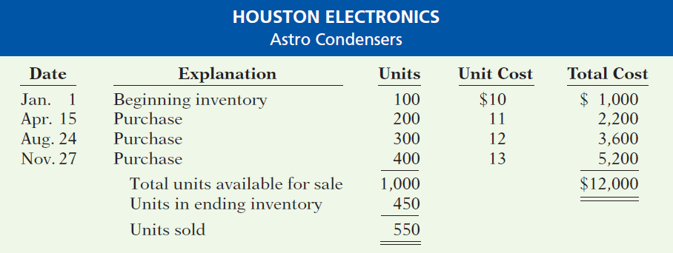
Cost Flow Assumptions
Illustration: Data for Houston Electronics’ Astro condensers.
Illustration 6-5
(Beginning Inventory + Purchases) - Ending Inventory = Cost of Goods Sold
LO 2 Explain the accounting for inventories and apply the inventory cost flow methods.

Slide 12
Cost Flow Assumptions
First-In, First-Out (FIFO)
  Costs of the earliest goods purchased are the first to be recognized in determining cost of goods sold.
  Often parallels actual physical flow of merchandise.
  Companies determine the cost of the ending inventory by taking the unit cost of the most recent purchase and working backward until all units of inventory have been costed.
LO 2 Explain the accounting for inventories and apply the inventory cost flow methods.

Slide 13
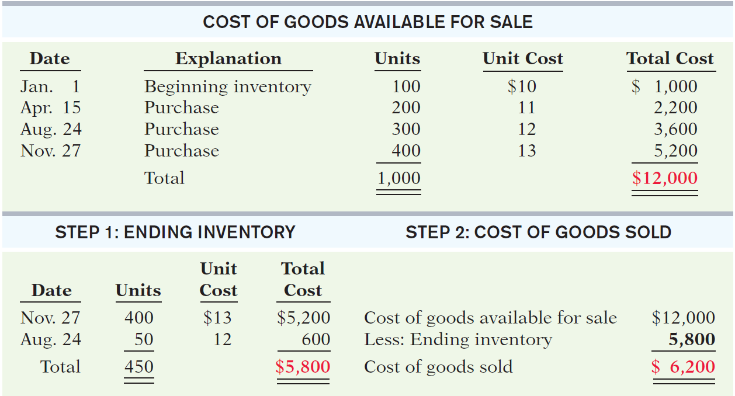
Cost Flow Assumptions
First-In, First-Out (FIFO)
Illustration 6-6
COST OF GOODS AVAILABLE FOR SALE
STEP 1: ENDING INVENTORY STEP 2: COST OF GOODS SOLD
LO 2

Slide 14
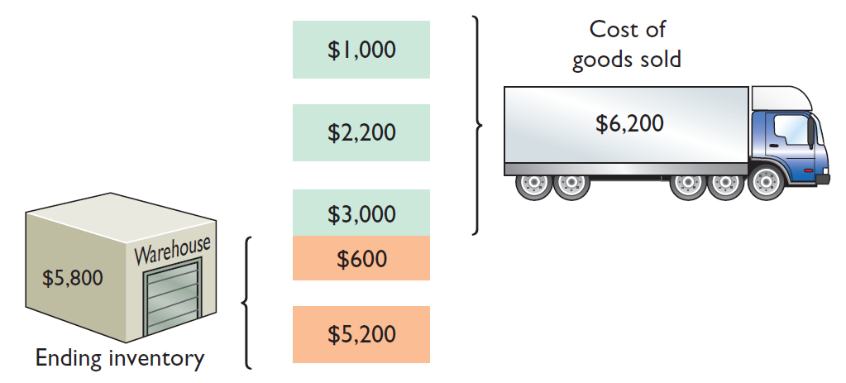
Cost Flow Assumptions
First-In, First-Out (FIFO)
Illustration 6-6
Helpful Hint Another way of
thinking about the calculation
of FIFO ending inventory is the
LISH assumption—last in still here.
LO 2 Explain the accounting for inventories and apply the inventory cost flow methods.

Slide 15
Cost Flow Assumptions
Last-In, First-Out (LIFO)
  Costs of the latest goods purchased are the first to be recognized in determining cost of goods sold.
LO 2 Explain the accounting for inventories and apply the inventory cost flow methods.

Slide 16
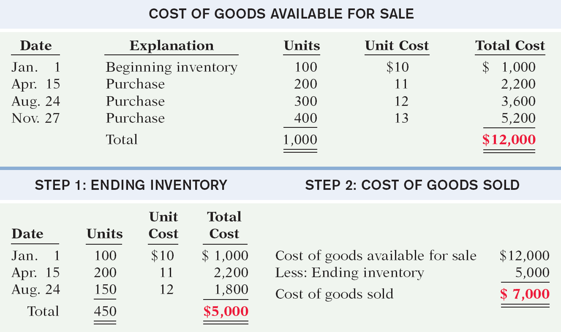
Cost Flow Assumptions
Last-In, First-Out (LIFO)
Illustration 6-8
COST OF GOODS AVAILABLE FOR SALE
STEP 1: ENDING INVENTORY STEP 2: COST OF GOODS SOLD
LO 2

Slide 17
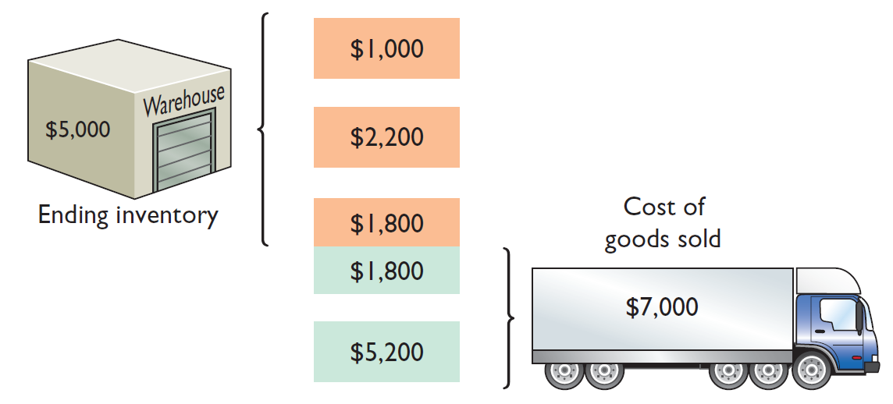
Cost Flow Assumptions
Last-In, First-Out (LIFO)
Helpful Hint Another way of
thinking about the calculation
of LIFO ending inventory is the
FISH assumption—first in still here.
Illustration 6-8
LO 2 Explain the accounting for inventories and apply the inventory cost flow methods.

Slide 18
Cost Flow Assumptions
Average-Cost
  Allocates cost of goods available for sale on the basis of weighted-average unit cost incurred.
  Applies weighted-average unit cost to the units on hand to determine cost of the ending inventory.
LO 2 Explain the accounting for inventories and apply the inventory cost flow methods.

Slide 19
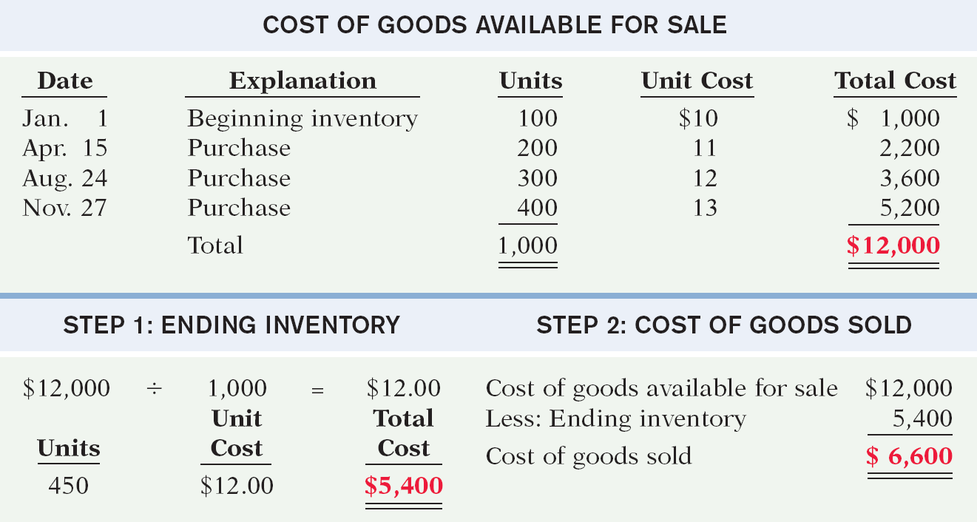
Cost Flow Assumptions
Average-Cost
Illustration 6-11
COST OF GOODS AVAILABLE FOR SALE
STEP 1: ENDING INVENTORY STEP 2: COST OF GOODS SOLD
LO 2 Explain the accounting for inventories and apply the inventory cost flow methods.

Slide 20
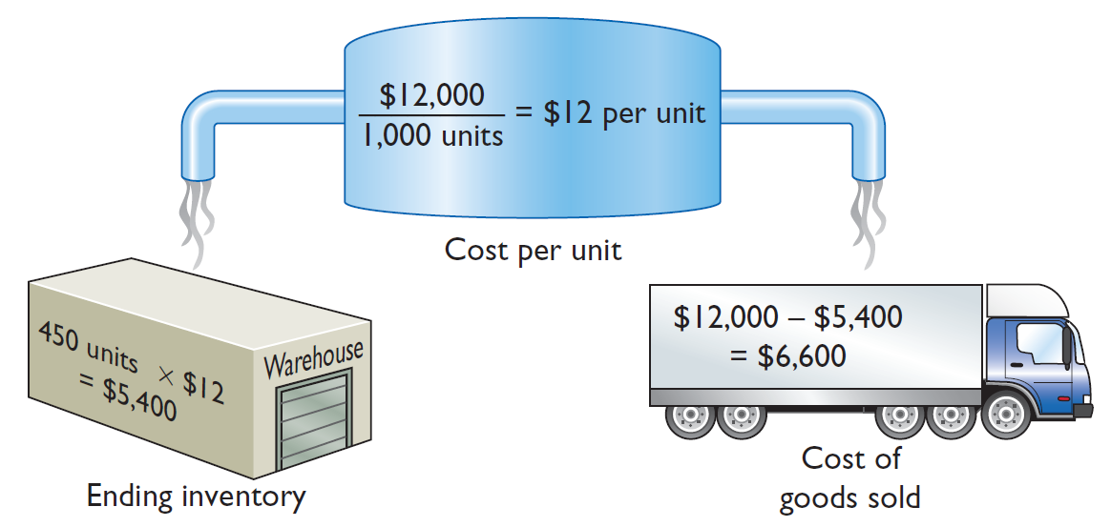
Cost Flow Assumptions
Average-Cost
Illustration 6-11
LO 2 Explain the accounting for inventories and apply the inventory cost flow methods.

Slide 21
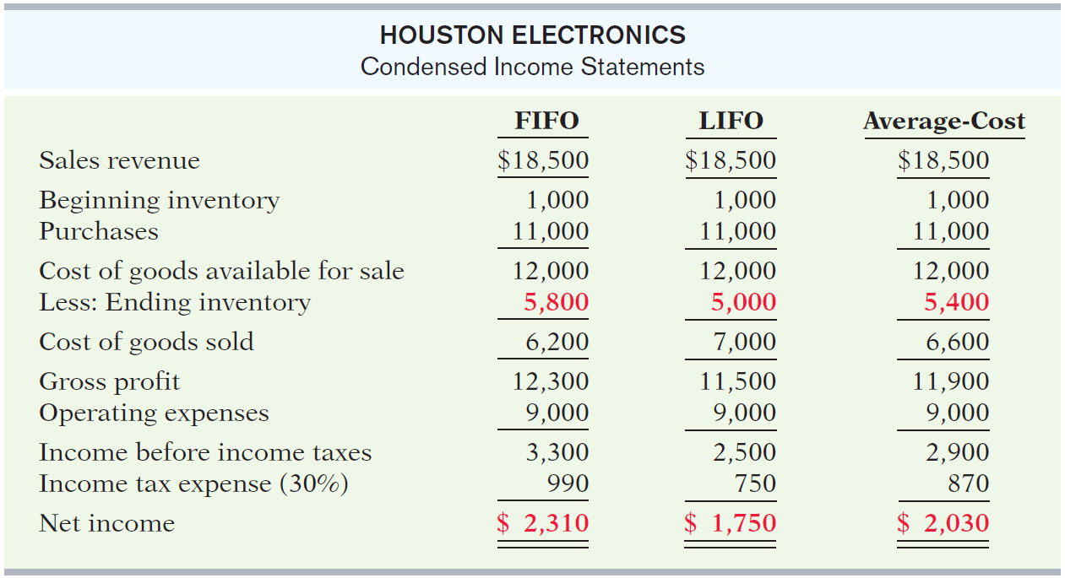
Financial Statement and Tax Effects
Comparative effects of cost flow methods
Illustration 6-13
HOUSTON ELECTRONICS
Condensed Income Statements
LO 3 Explain the financial effects of inventory cost flow assumptions.

Slide 22
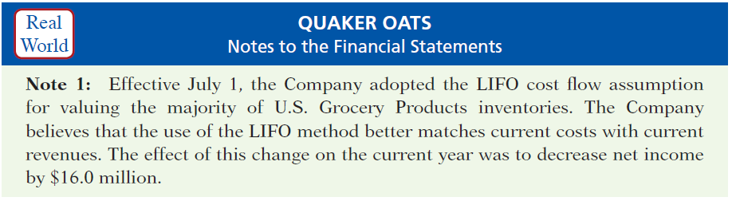
Inventory Costing
Using Cost Flow Methods Consistently
  Method should be used consistently, enhances comparability.
  Although consistency is preferred, a company may change its inventory costing method.
Illustration 6-15
Disclosure of change in cost flow method

Slide 23
Cost Flow Assumptions
Review Question
The cost flow method that often parallels the actual physical flow of merchandise is the:
  FIFO method.
  LIFO method.
  average cost method.
  gross profit method.
LO 3 Explain the financial effects of inventory cost flow assumptions.
Notes:
Answer = A

Slide 24
Cost Flow Assumptions
Review Question
In a period of inflation, the cost flow method that results in the lowest income taxes is the:
  FIFO method.
  LIFO method.
  average cost method.
  gross profit method.
Helpful Hint A tax rule,
often referred to as the LIFO
conformity rule, requires that
if companies use LIFO for tax
purposes, they must also use it
for financial reporting purposes. This means that if a company chooses the LIFO method to reduce its tax bills, it will also have to report lower net income in its financial statements.
LO 3 Explain the financial effects of inventory cost flow assumptions.
Notes:
Answer = B

Slide 25
Inventory Costing
Lower-of-Cost-or-Market
When the value of inventory is lower than its cost
  Companies “write down” the inventory to its market value in the period in which the price decline occurs.
  Market value = Replacement Cost
  Example of conservatism.
International Note Under
U.S. GAAP, companies cannot
reverse inventory write-downs
if inventory increases in
value in subsequent periods.
IFRS permits companies to
reverse write-downs in some
circumstances.
LO 4 Explain the lower-of-cost-or-market basis of accounting for inventories.

Slide 26
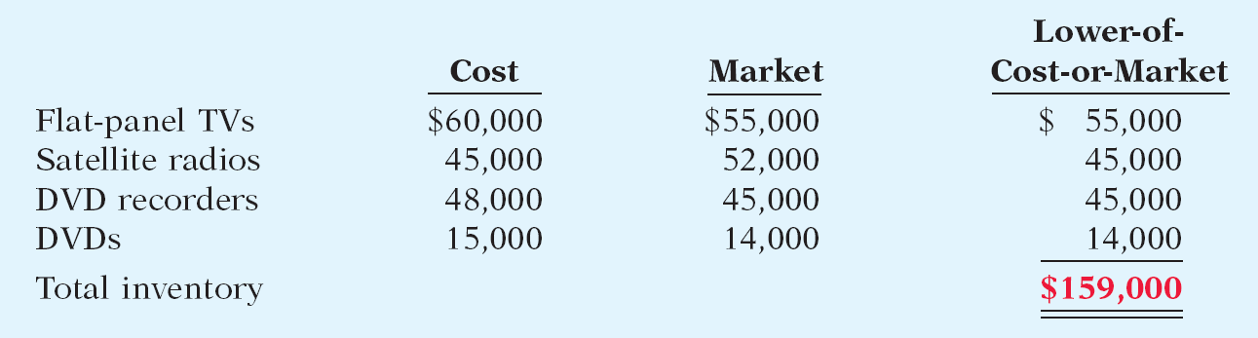
Inventory Costing
Lower-of-Cost-or-Market
Illustration: Assume that Ken Tuckie TV has the following lines of merchandise with costs and market values as indicated.
Illustration 6-16
LO 4 Explain the lower-of-cost-or-market basis of accounting for inventories.

Slide 27
Inventory Errors
Common Cause:
  Failure to count or price inventory correctly.
  Not properly recognizing the transfer of legal title to goods in transit.
  Errors affect both the income statement and balance sheet.
LO 5 Indicate the effects of inventory errors on the financial statements.

Slide 28

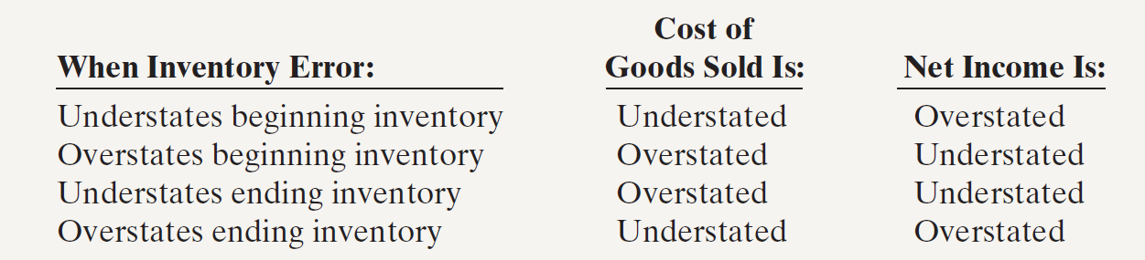
Inventory Errors
Income Statement Effects
Inventory errors affect the computation of cost of goods sold and net income.
Illustration 6-17
Illustration 6-18
LO 5 Indicate the effects of inventory errors on the financial statements.

Slide 29
Inventory Errors
Income Statement Effects
Inventory errors affect the computation of cost of goods sold and net income in two periods.
  An error in ending inventory of the current period will have a reverse effect on net income of the next accounting period.
  Over the two years, the total net income is correct because the errors offset each other.
  Ending inventory depends entirely on the accuracy of taking and costing the inventory.
LO 5 Indicate the effects of inventory errors on the financial statements.

Slide 30
Inventory Errors
Illustration 6-19
Combined income for 2-year period is correct.
($3,000)
Net Income understated
$3,000
Net Income overstated
LO 5 Indicate the effects of inventory errors on the financial statements.

Slide 31
Inventory Errors
Question
Understating ending inventory will overstate:
  assets.
  cost of goods sold.
  net income.
  owner's equity.
LO 5 Indicate the effects of inventory errors on the financial statements.

Slide 32
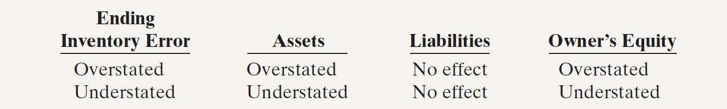
Inventory Errors
Balance Sheet Effects
Effect of inventory errors on the balance sheet is determined by using the basic accounting equation:.
Illustration 6-17
Illustration 6-20
LO 5 Indicate the effects of inventory errors on the financial statements.

Slide 33
Statement Presentation and Analysis
Presentation
Balance Sheet - Inventory classified as current asset.
Income Statement - Cost of goods sold subtracted from sales.
There also should be disclosure of
  major inventory classifications,
  basis of accounting (cost or LCM), and
  costing method (FIFO, LIFO, or average).

Slide 34
Statement Presentation and Analysis
Analysis
Inventory management is a double-edged sword
  High Inventory Levels - may incur high carrying costs (e.g., investment, storage, insurance, obsolescence, and damage).
  Low Inventory Levels – may lead to stockouts and lost sales.
LO 6 Compute and interpret the inventory turnover.

Slide 35
Statement Presentation and Analysis
Inventory turnover measures the number of times on average the inventory is sold during the period.
Cost of Goods Sold
Inventory Turnover
=
Average Inventory
Days in inventory measures the average number of days inventory is held.
Days in Year (365)
Days in Inventory
=
Inventory Turnover
LO 6 Compute and interpret the inventory turnover.

Slide 36
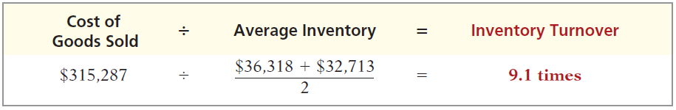
Statement Presentation and Analysis
Illustration: Wal-Mart reported in its 2011 annual report a beginning inventory of $32,713 million, an ending inventory of $36,318 million, and cost of goods sold for the year ended January 31, 2011, of $315,287 million. The inventory turnover formula and computation for Wal-Mart are shown below.
Illustration 6-22
Days in Inventory: Inventory turnover of 9.1 times divided into 365 is approximately 40.1 days. This is the approximate time that it takes a company to sell the inventory.
LO 6 Compute and interpret the inventory turnover.

